Slide 1
Dimensionality Reduction
(part 1 of 2)
Why reduce dimensionality?
Methods for reducing dimensionality
One common technique: Principal Components Analysis (PCA)
Crude facial recognition with PCA and kNN (i.e. Eigenfaces)
Ryan Henning

Slide 2
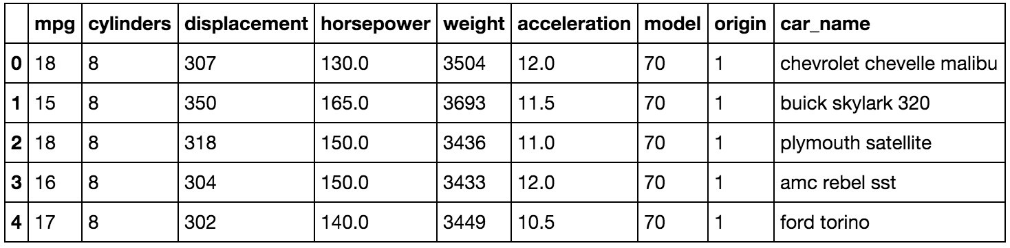
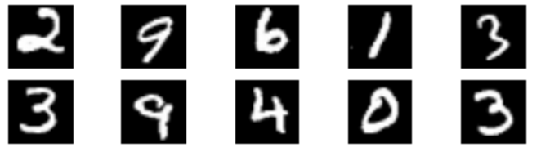
Before we go on:
What is the dimensionality of our data?
Here are some different words for the same thing…
“dimension” = “feature” = “predictor”
“dimensionality” = “number of features” = “number of predictors”
How many dimensions is this dataset?
How many dimensions is this dataset?
Notes:
First dataset (the table of cars):
Each column in the table is a single “feature”, “predictor”, “dimension”. (You can choose which word you like best.) There are 9 dimensions in the first dataset.
Imagine if we just had two columns… we could plot each row as a point in a cartesian plane.
Now go back to having all 9 columns… we can still think of each row as a point in a 9-dimensional space.
The second dataset (MNIST):
What if we have an image… how many dimensions is it? (dimensionality = #pixels*#channels = 28*28*1 = 784) Can we consider it a single point in a high-dimensional space? (yes)

Slide 3
Why reduce dimensionality?
HIgh dimensional data causes many problems. Here are a few:
The Curse of Dimensionality:
Points are “far away” in high dimensions, and it’s easy to overfit small datasets. (see kNN / Decision Tree slides for a review of The Curse)
Visualization:
It’s hard to visualize anything with more than 3 dimensions.
Latent Features:
Often (especially with image/video data) the most relevant features are not explicitly present in the high dimensional (raw) data.
Remove Correlation:
With many many features (dimensions) you can bet on there being a ton of correlation (e.g. consider neighboring pixels in an image dataset).
Notes:
Questions: On kNN day, what’s the main reason why kNN fails? The Curse of Dimensionality.
Example of latent features in an image: MNIST--in all those 784 dimensions, not a single one encodes the digit represented in the image.
If you have p predictors, you have p(p-1)/2 pairs of predictors. That’s a lot. You’ll surely find that many of those pair are highly correlated.

Slide 4
Methods for reducing dimensionality
There are a number of ways to reduce the dimensionality of your dataset:
Subset selection of features; e.g. forward stepwise selection
LASSO regression
Relaxed LASSO:
(1) do LASSO regression, (2) throw away unused features, (3) do OLS regression
Neural networks:
For labeled data: feature extraction via upper-layer outputs
For labeled or unlabeled data: autoencoders
Principal Components Analysis (PCA)
This is the primary topic today, but first let’s review these other methods.

Slide 5
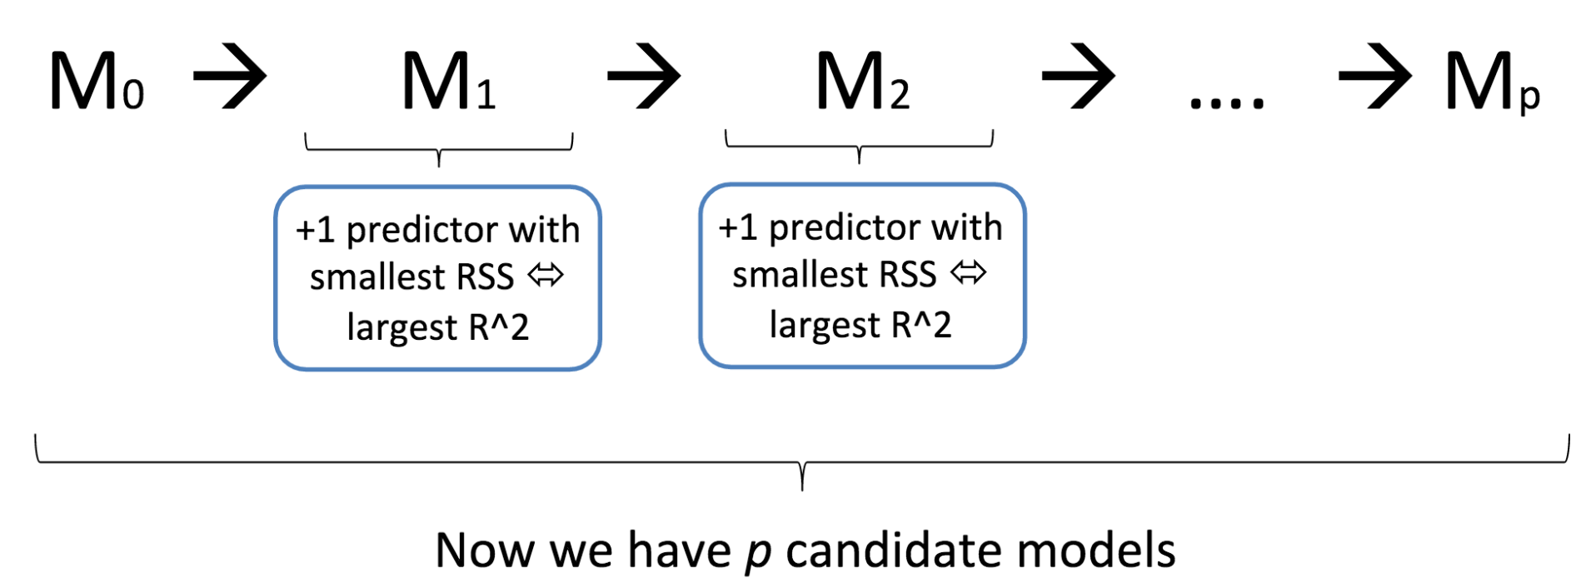
Review: Forward stepwise subset selection of features
Use Mallow’s C_{p}, or AIC, or BIC, or Adjusted R², or cross-validation to choose which of these p models to use in production.
Notes:
This is the first, most trivial, and most straightforward way to reduce dimensionality. Just throw away some of the features. Use cross-validation to decide how many features to throw away.

Slide 6
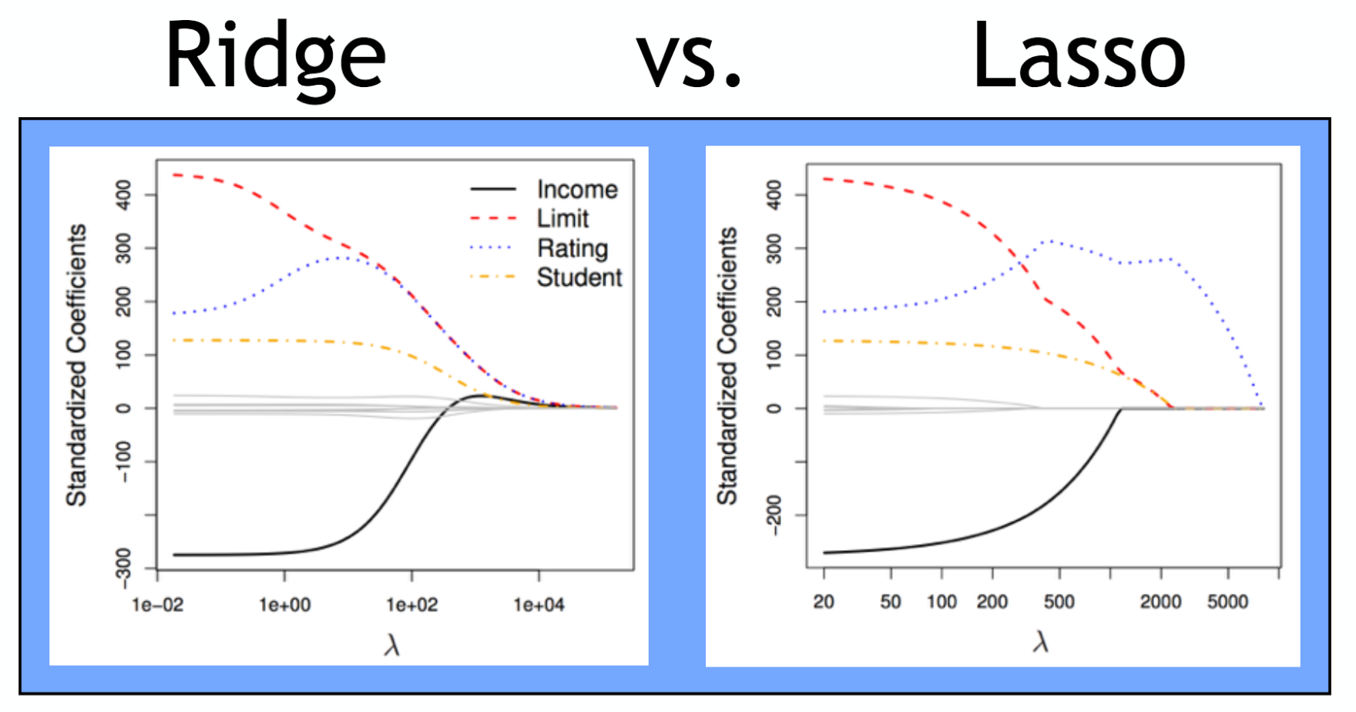
Review: LASSO regression for creating sparse models

Slide 7
Relaxed LASSO (Meinshausen, 2006)
1. Use cross-validation and LASSO regression; find the best value for lambda.
2. Keep only the features with non-zero coefficients.
3. Re-fit using ordinary least squares (OLS) regression. (I.e. Re-fit using no regularization!)
Notes:
http://stat.ethz.ch/~nicolai/relaxo.pdf

Slide 8
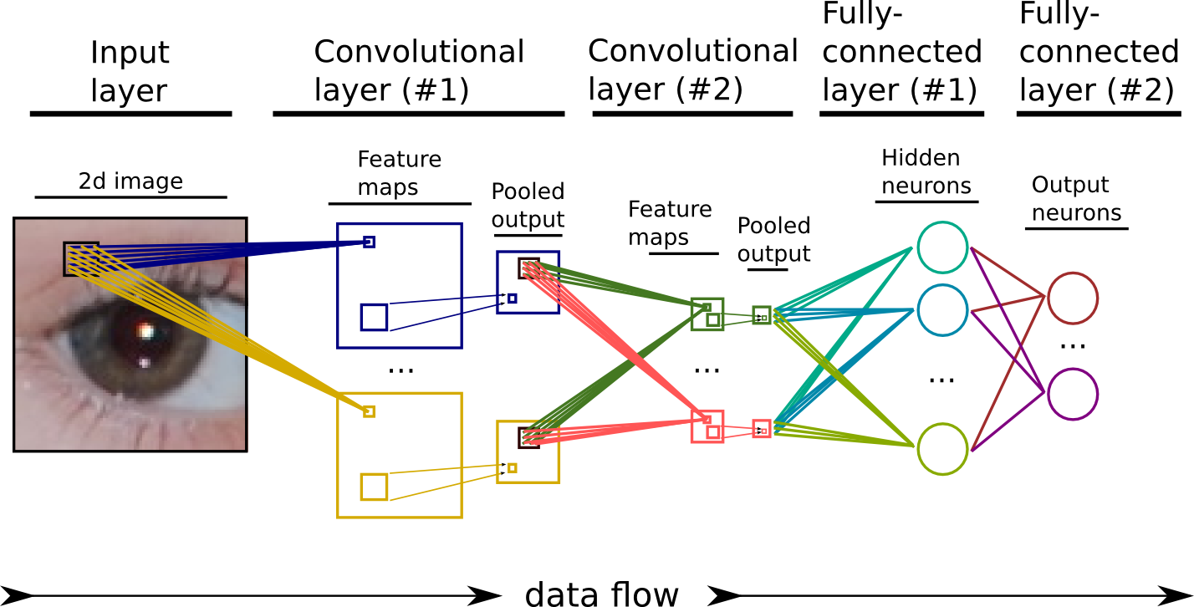
Upper-layer features in Neural Networks
(for labeled training data)
Train the network, then interpret the output of these neurons as high-level features!
(This is called feature extraction.)

Slide 9
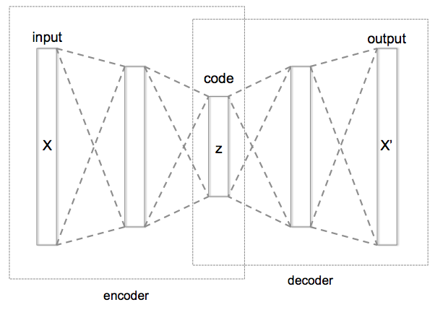
Autoencoders
(for labeled or unlabeled training data)
Autoencoders are neural networks. Instead of having the network learn a target, you have the network learn to reconstruct the input.
The catch is that you force the information through a bottleneck hidden layer.
Converges on PCA...
Notes:
https://commons.wikimedia.org/wiki/File%3AAutoencoder_structure.png
By Chervinskii (Own work) [CC BY-SA 4.0 (http://creativecommons.org/licenses/by-sa/4.0)], via Wikimedia Commons

Slide 10
Principal Components Analysis (PCA)
PCA is common technique for dimensionality reduction. It doesn’t require labeled data!
The first goal of PCA is to remove correlation between features.
A side effect is that we can use the process to reduce the dimensionality of our data while preserving most of the variance in our data.
Let’s derive PCA on the board!

Slide 11
Principal Components Analysis (PCA) (summary from boardwork)
Create the centred design matrix. Center your data by subtracting the mean. Put your centered data in matrix form where each row is one example. Call this the centered design matrix M.
Compute the covariance matrix. The covariance matrix is computed by M^{T}M.
The principal components are the eigenvectors of the covariance matrix. Ordering the eigenvectors by decreasing corresponding eigenvalues, you get an uncorrelated and orthogonal basis capturing the directions of most-to-least variance in your data.

Slide 12
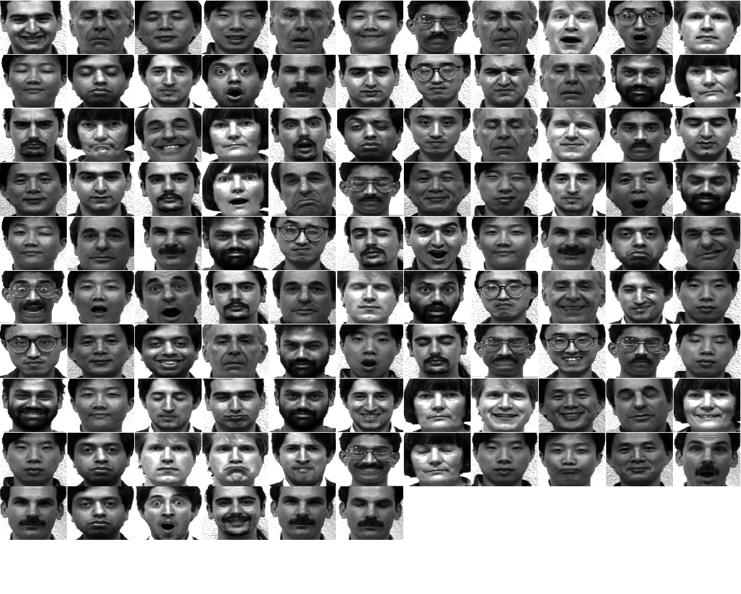
Our dataset
From the Yale Face Database (using subset of 105 images)
320x243 pixels each, grayscale
Centered and cropped identically

Slide 13
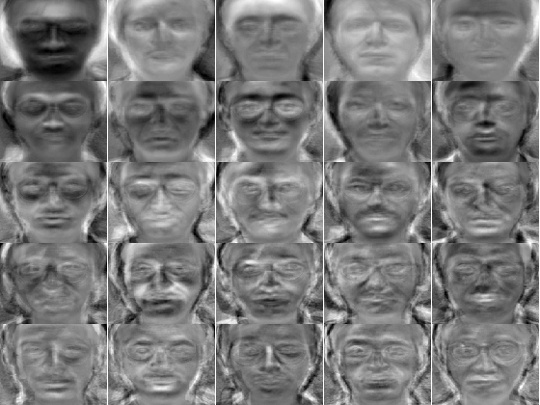
Let’s do PCA on this dataset of faces!
Pause… let’s make sure we’re all on the same page.
What do you expect will happen?
This! We call these eigenfaces, because they are the eigenvectors of the face database covariance matrix.
What do you see here? What is each eigenface capturing?
Notes:
Each eigenface represents a direction of variance in the centered data. If we had a new image, we could project the new (centered) image onto an eigenface to see how much this new image deviated from the mean along the direction defined by the eigenface.
https://en.wikipedia.org/wiki/Eigenface

Slide 14
Drawbacks of Eigenfaces
Faces must be aligned eyes-to-eyes, mouth-to-mouth -- differences in translation and scale are captured by PCA (which isn’t what we want)
Faces must be lit the same -- differences in lighting are captured by PCA (which isn’t what we want).
Old method: 1987, 1991
Improvements:
“Fisherfaces”: uses LDA and labels to help remove lighting effects
Use PCA on shapes detected in the image (search for Active Shape Model)

Slide 15
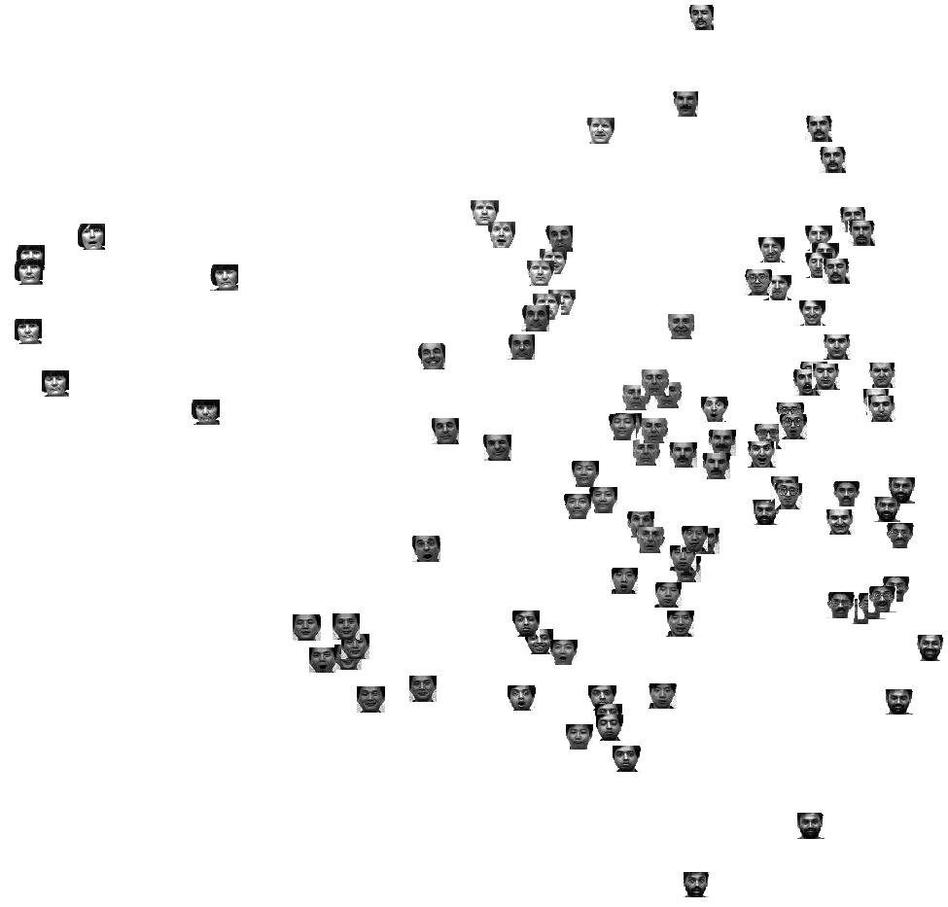
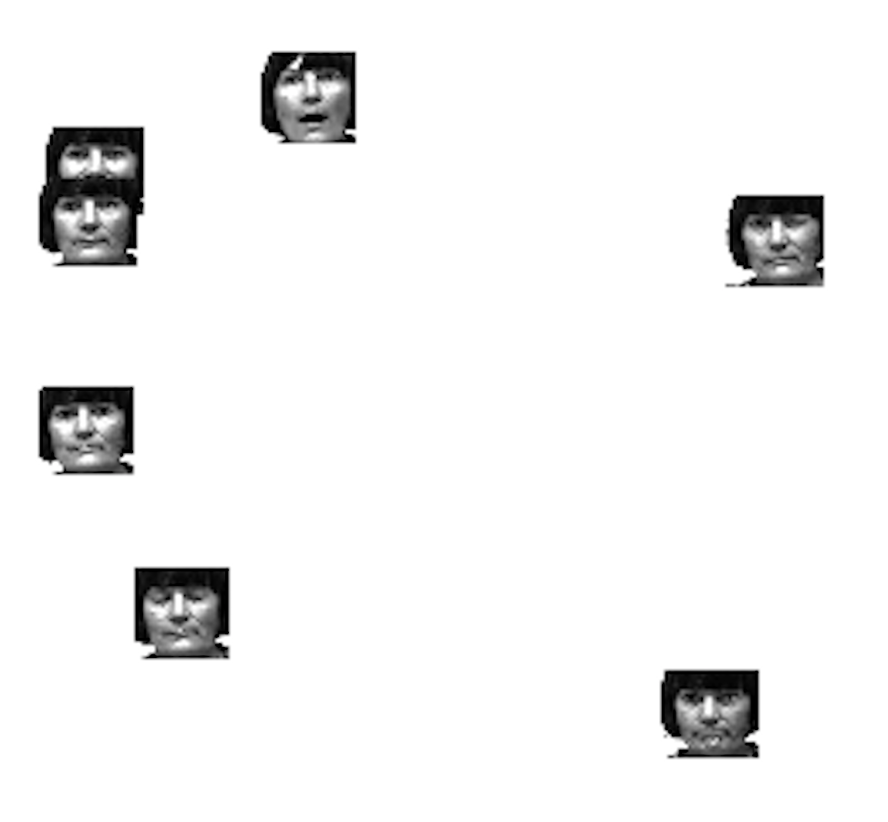
Crude facial recognition
Using PCA on cropped face images (i.e. eigenfaces), combined with kNN, we can do very crude facial recognition! To show this, let’s look at the embedding onto 2d.

Slide 16
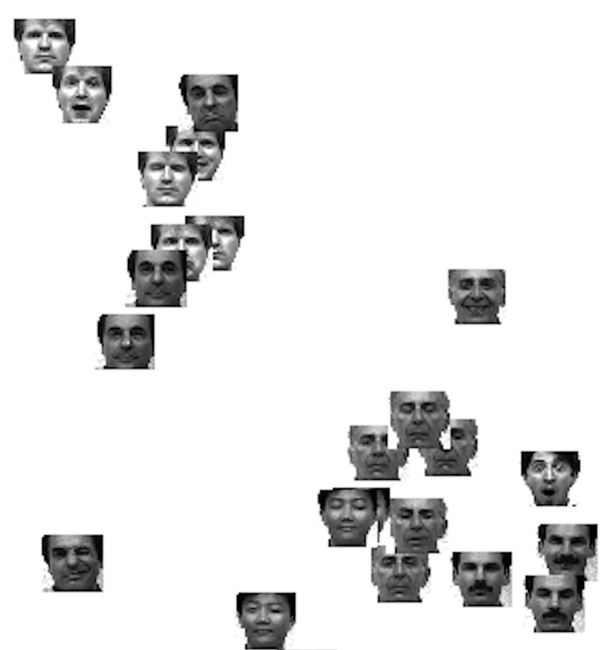
Crude facial recognition

Slide 17
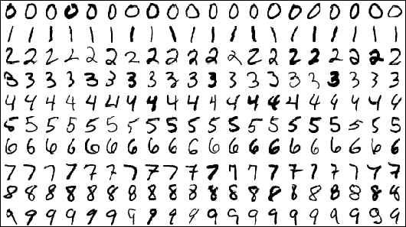
MNIST Dataset
Dataset of handwritten digits
10 classes (0-9)
28x28 pixels, grayscale = 784 dimensions
60,000 training images
10,000 test images

Slide 18
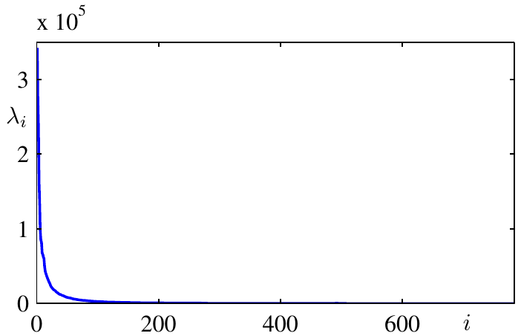
PCA on MNIST: What are the sizes of the eigenvalues?
Recall: The size of each eigenvector’s eigenvalue denotes the amount of variance captured by that eigenvector.
Look how fast the size of the eigenvalues drop!
Look for this “elbow”.

Slide 19
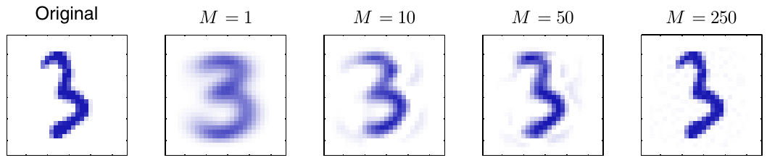
PCA on MNIST: Reconstructing the input by a linear combination of eigenvectors

Slide 20
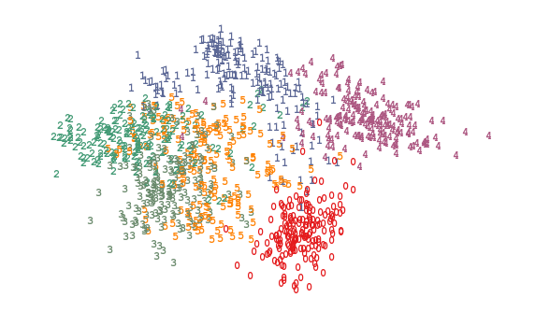
PCA on MNIST: Embedding in 2d

Slide 21
Dimensionality Reduction
(part 2 of 2)
Singular Value Decomposition (SVD)
SVD vs PCA
SVD for capturing latent features
Ryan Henning

Slide 22
When to use PCA
(general advice only!)
Use when:
kNN on high dimensional data
Clustering high dimensional data
Visualization (e.g. embeddings)
Working with images (e.g. would it work well to feed an image into a decision tree?)
Don’t use when:
You need to retain interpretability of your feature space
Your model doesn’t need reduced dimensional data (e.g. OLS on relatively small data)
Notes:
Here’s a degenerate dataset that shows how PCA can screw you over.
https://gist.github.com/lemonlaug/976543b650e53db24ab2

Slide 23
Singular Value Decomposition (SVD)
Boardwork...

Slide 24
SVD vs PCA
Boardwork...

Slide 25
SVD for capturing latent features
See IPython notebook…
The idea goes like this: Say our dataset maps from space X to space Y. E.g. X might be “user space”, and Y might be “movie space”.
After doing SVD on this dataset, we can interpret the SVD as mapping from X space to a “concept space”, then mapping from that “concept space” to Y space.
We then interpret this “concept space” as latent features of our dataset. We also sometimes call this space the “topic space”.

